Slide 1
Venn Diagrams
3-approaches

Slide 2
First Approach:
The approach we saw last class, answering the question where is the statement true?

Slide 3
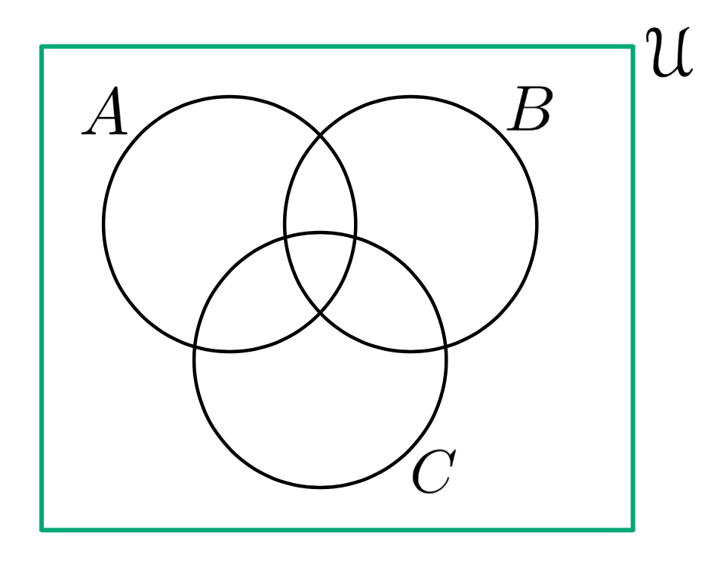
First Approach:

Slide 4
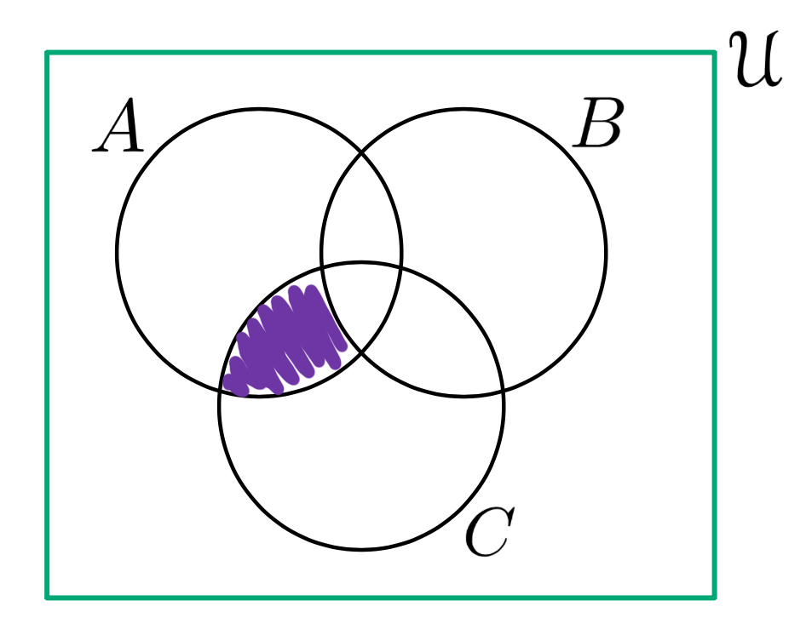
First Approach:
(T and T) and F
(F and F) and F
(F and F) and T
?
?
?
(F and T) and T
(F and T) and F
?
?
?
(T and F) and F
(T and F) and T
?
?
(T and T) and T

Slide 5
Second Approach:
Break it down in pieces like we did with
truth tables!
(That’s right it’s all logic)

Slide 6
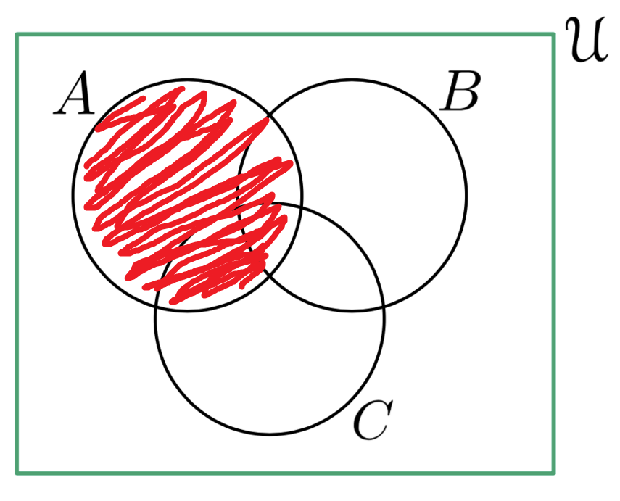
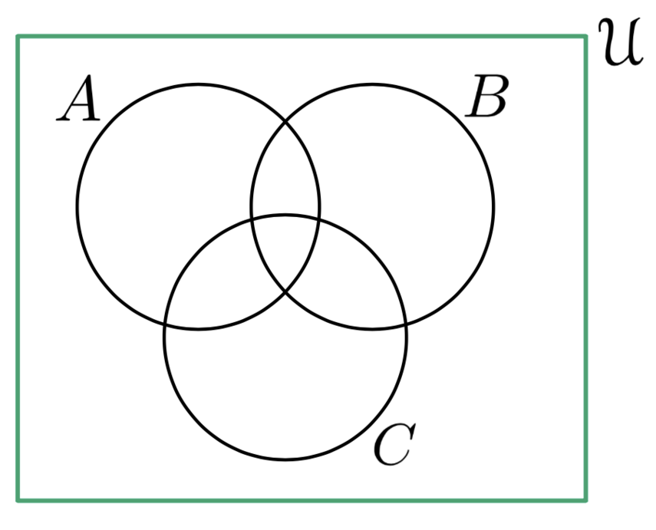
Second Approach:

Slide 7
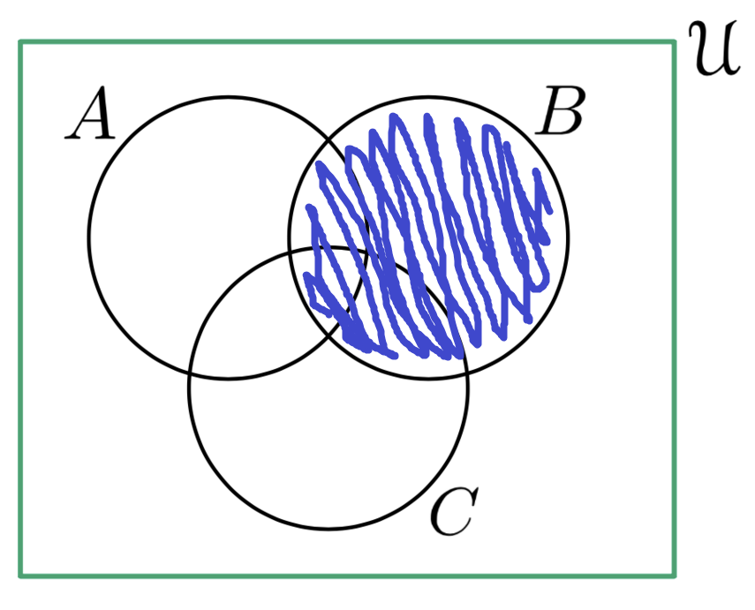
Second Approach:

Slide 8
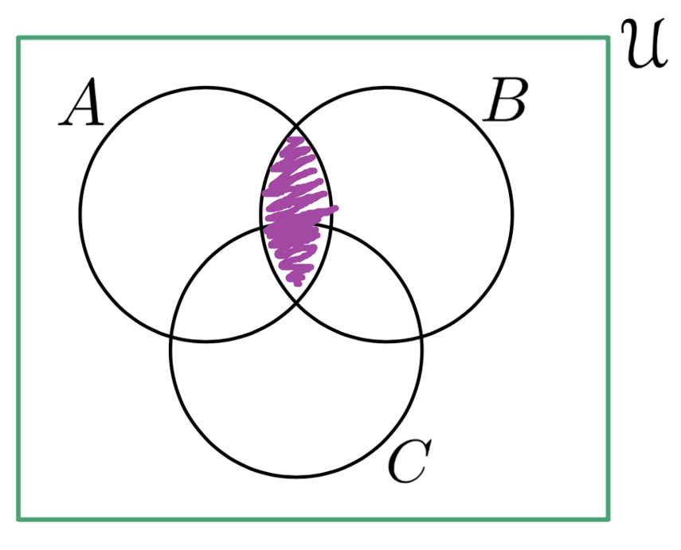
Second Approach:

Slide 9
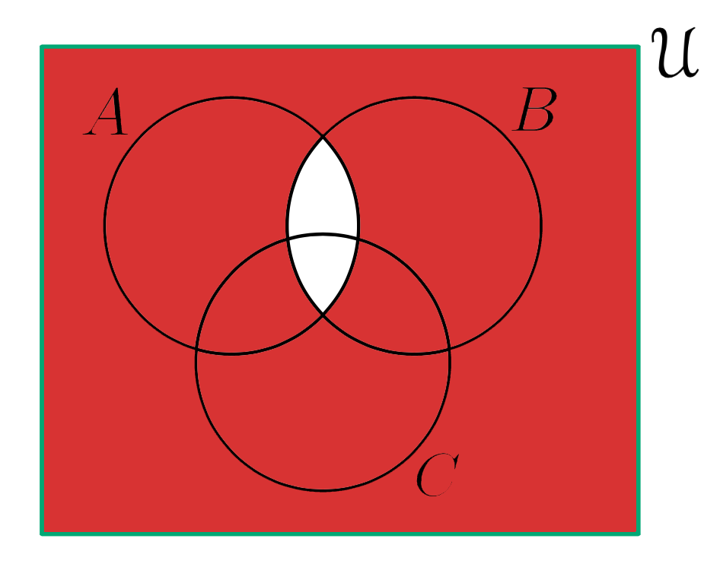
Second Approach:

Slide 10
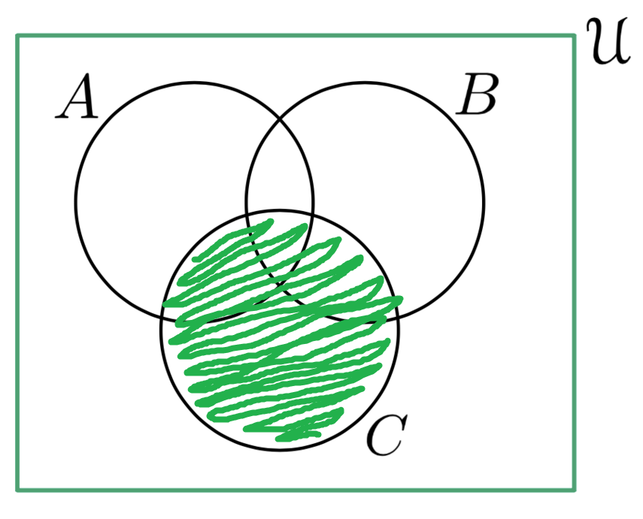
Second Approach:

Slide 11
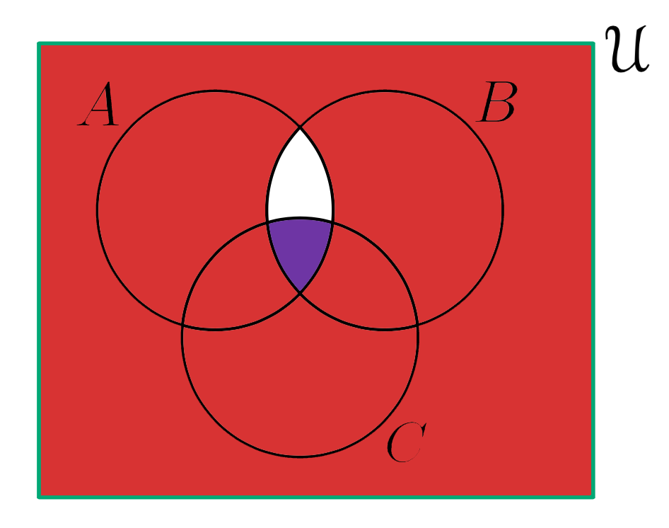
Second Approach:

Slide 12
Third Approach:
Logic is just words!
Remember?

Slide 13
Third Approach:
So
says: All the stuff not in
says: All the stuff not in
says: All the stuff NOT in OR NOT in
says: All the stuff NOT in OR NOT in BUT IS in

Slide 14
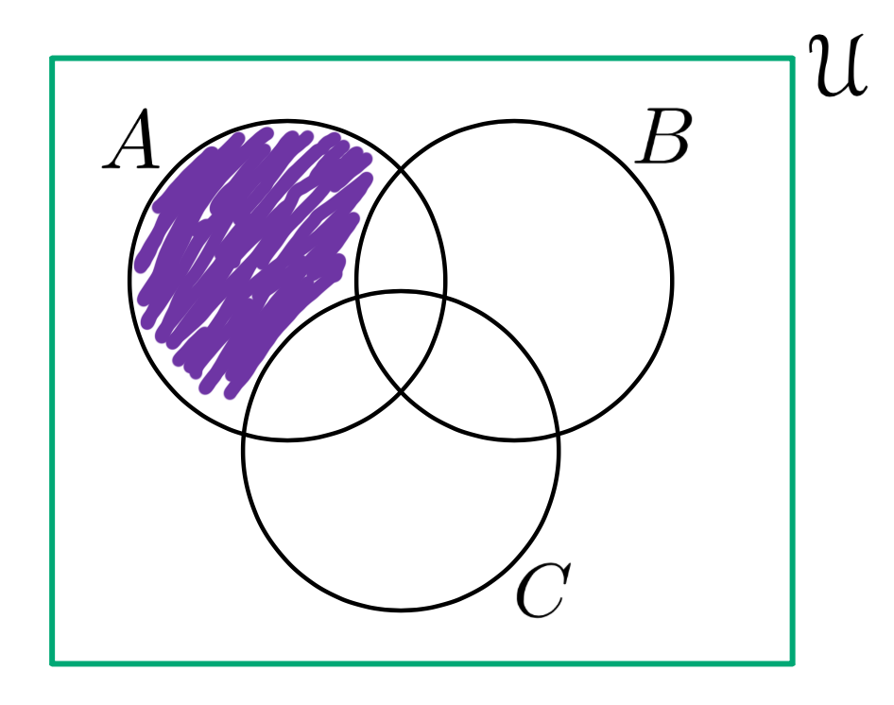
Third Approach:

Slide 15
Cardinality
(back to cardinality… do we remember that?)

Slide 16
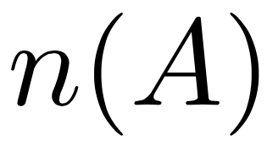
Recall:
We denote the number of elements of a set as

Slide 17
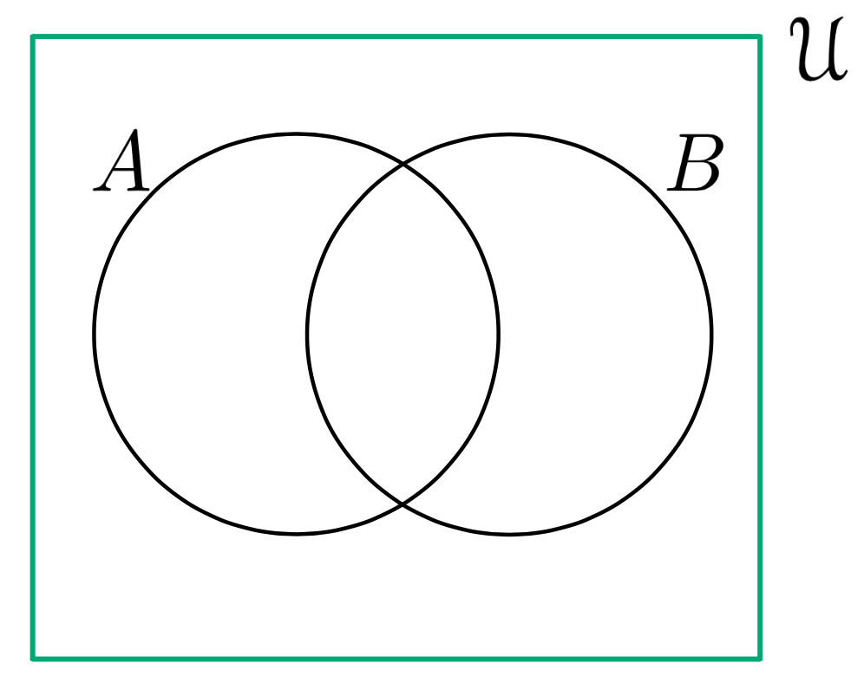
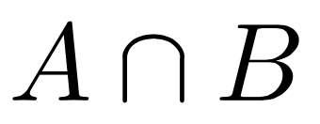
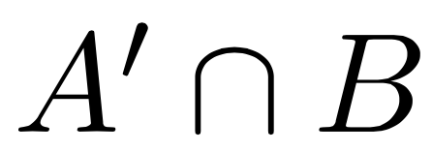
Where is all the stuff?

Slide 18
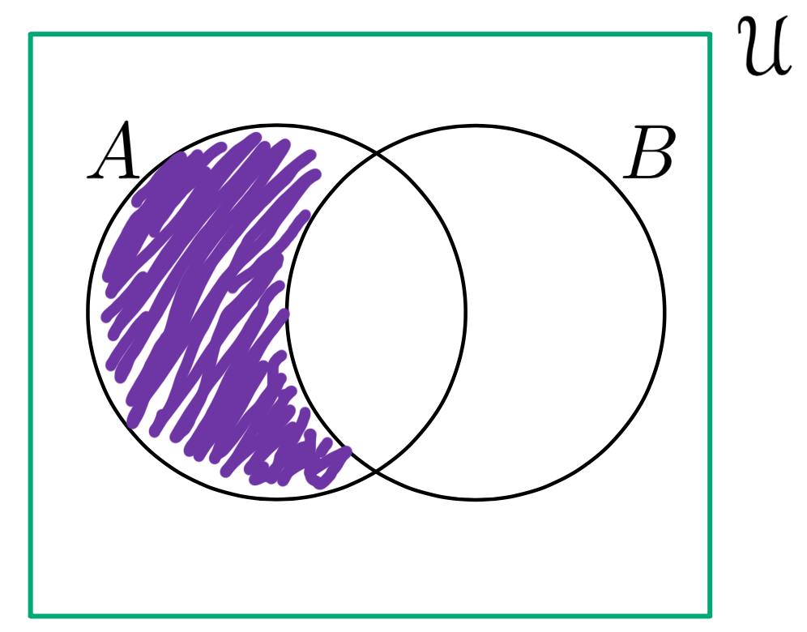
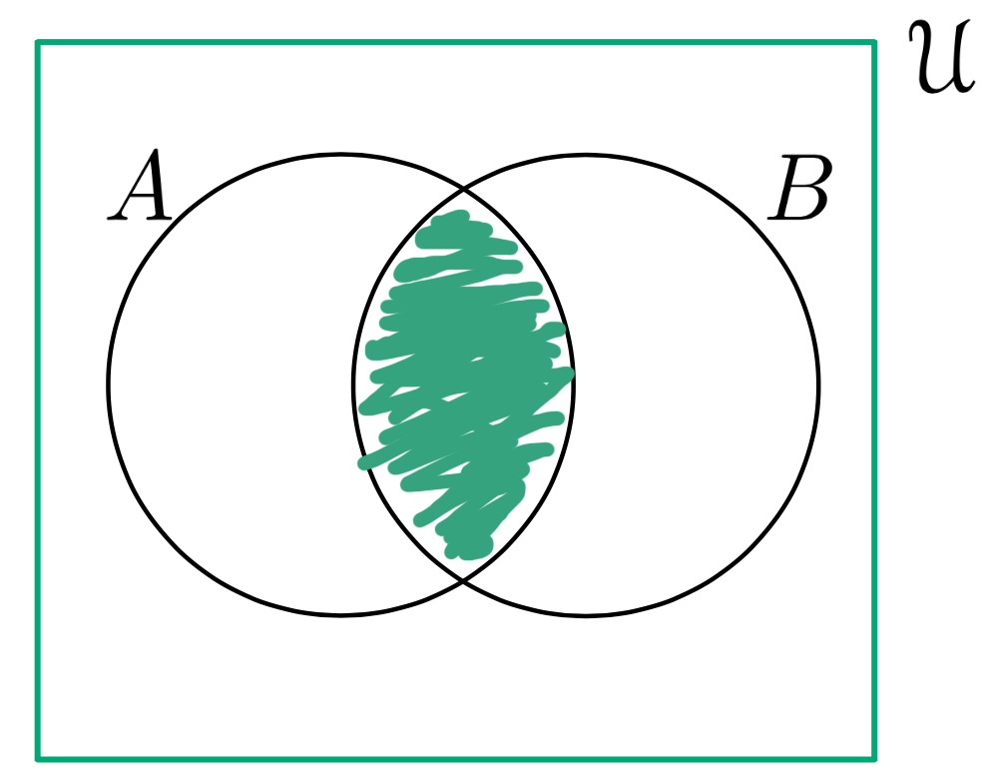
Where is all the stuff?

Slide 19
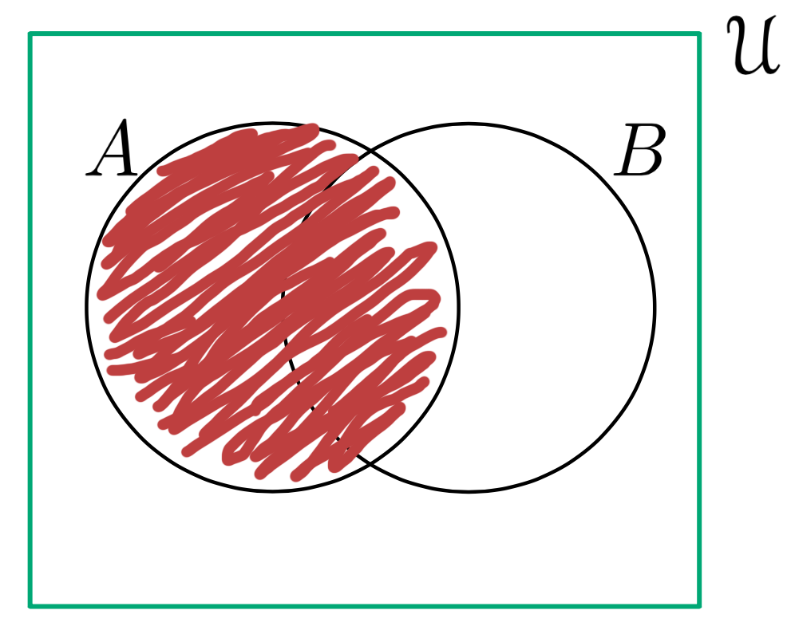
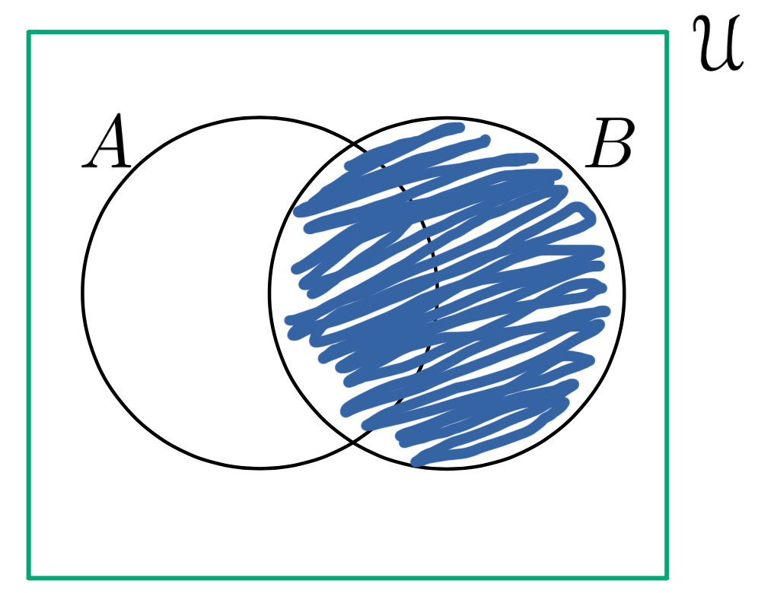
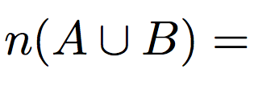
Where is all the stuff?

Slide 20
Everybody Loves Puzzles! (and the Super Bowl)
Ninety People at a Super Bowl party were surveyed to see what they ate while watching the game. The following data was collected:
48 had potato skins
39 had wings
35 had nachos
20 had both wings and nachos
19 had both potato skins and nachos
22 had both wings and potato skins
10 had all three
How many had nothing?

Slide 21
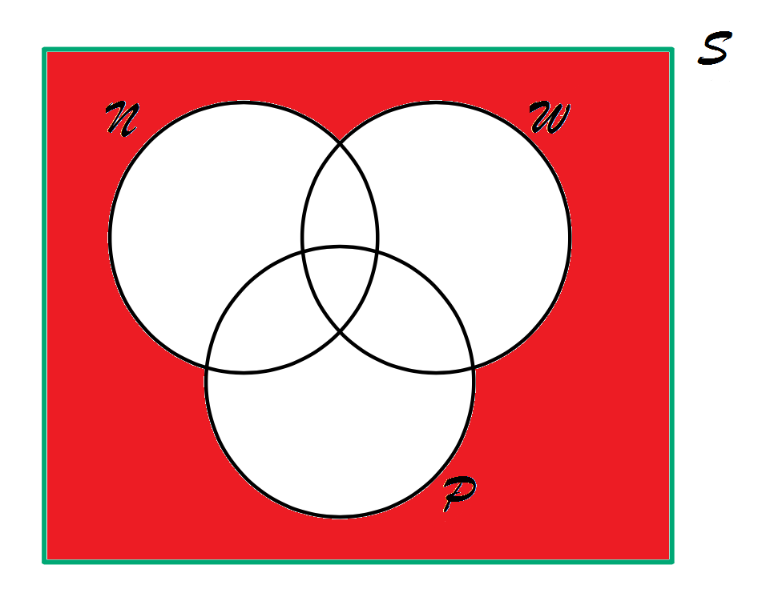
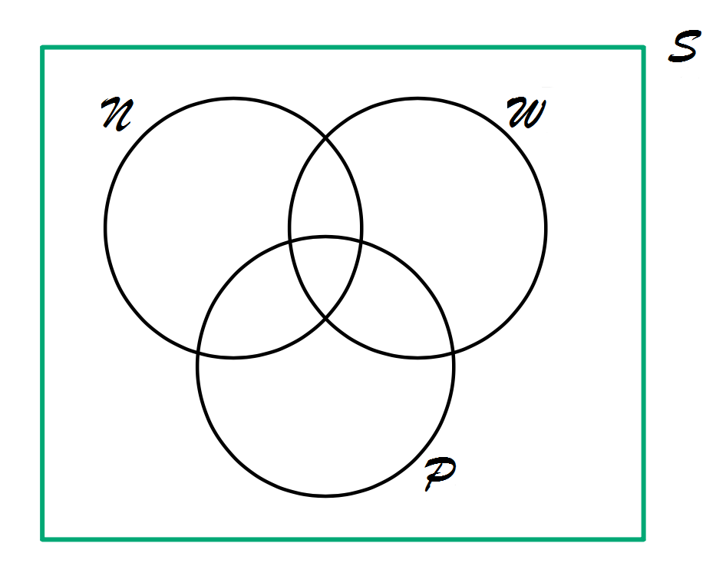
No Food? Party Pooper!

Slide 22
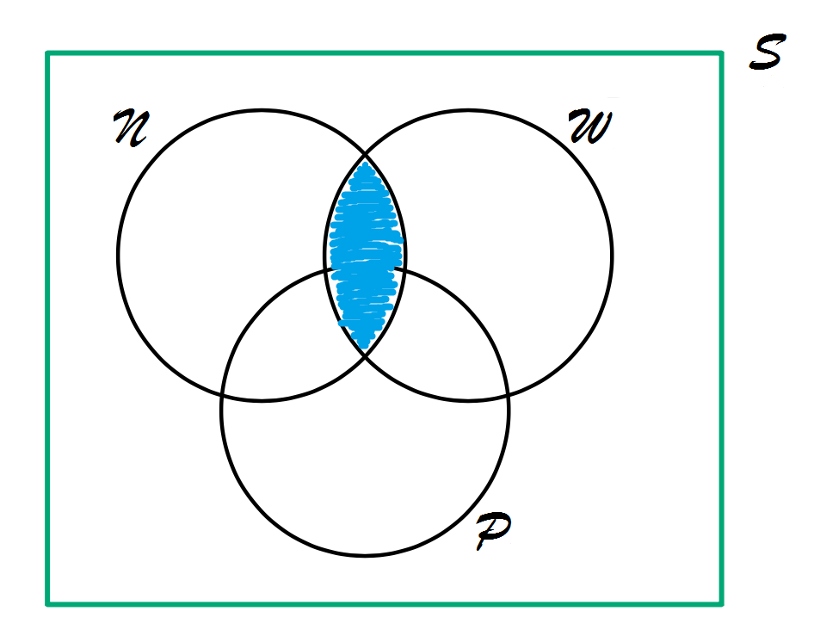
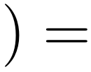
20

Slide 23
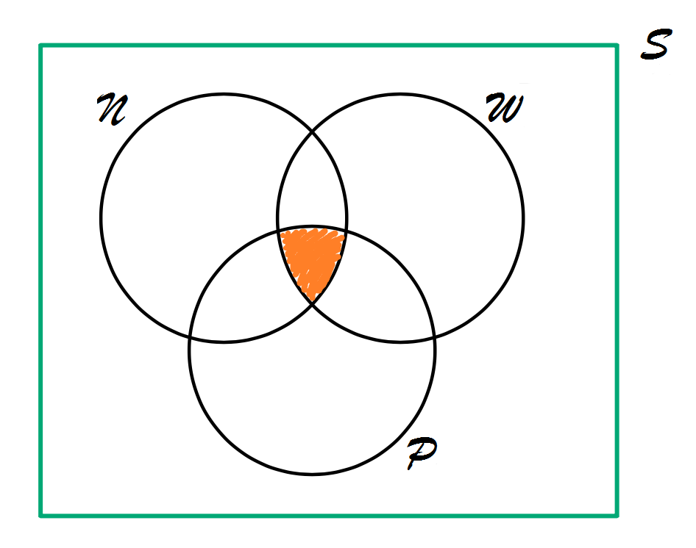
10

Slide 24
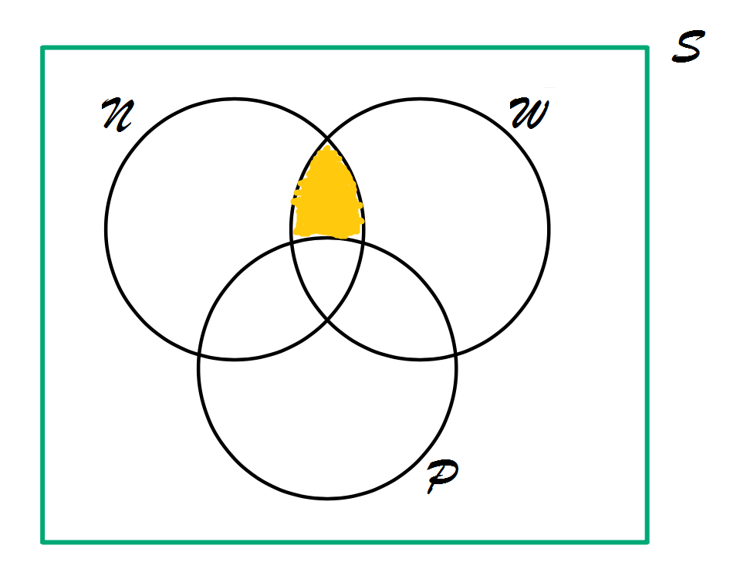
20
10
=10

Slide 25
No Food? Party Pooper!
10
10

Slide 26
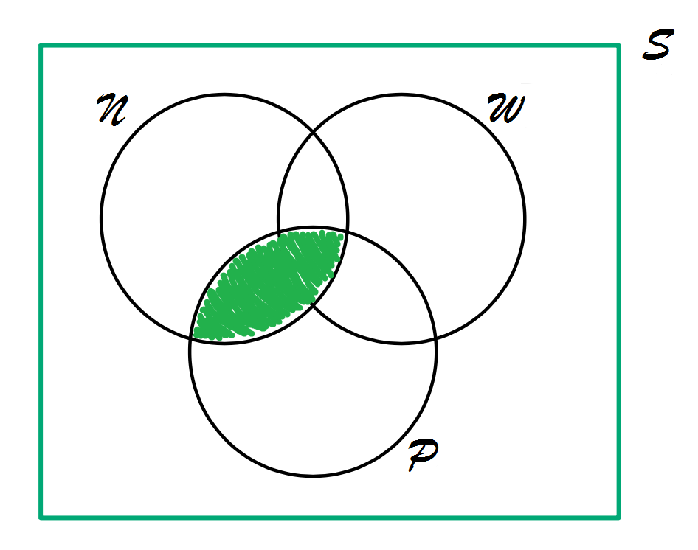
19

Slide 27
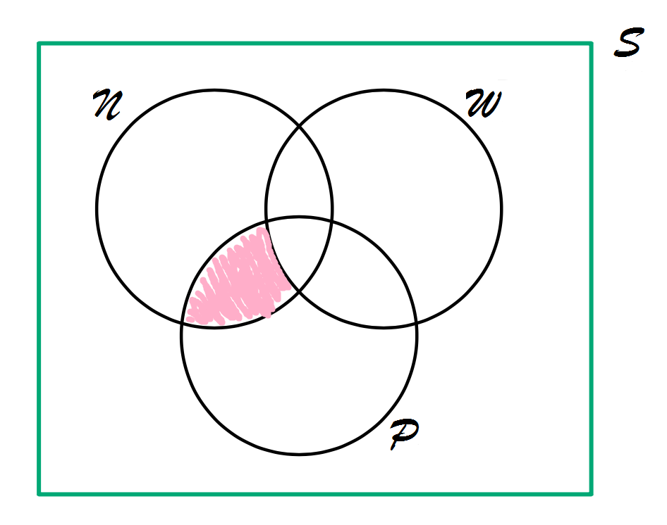
10
=9
19

Slide 28
No Food? Party Pooper!
10
10
9

Slide 29
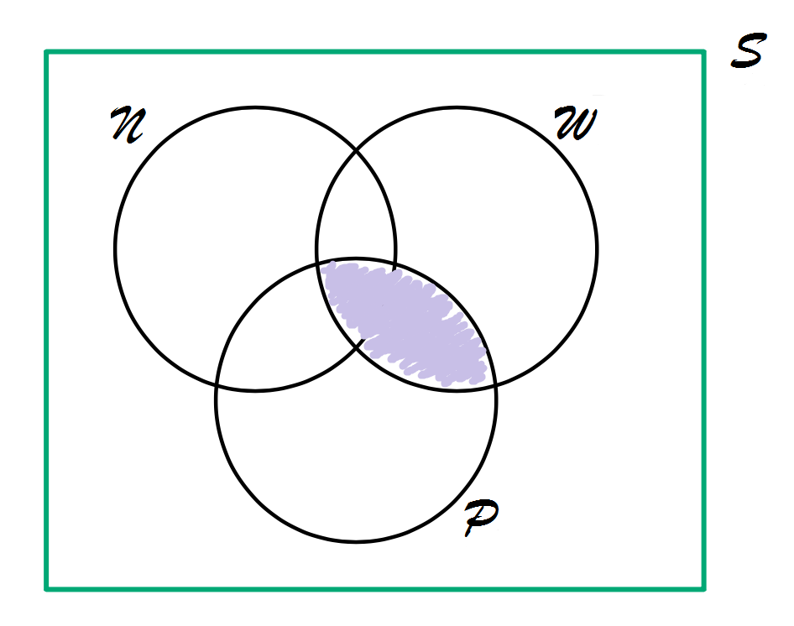
22

Slide 30
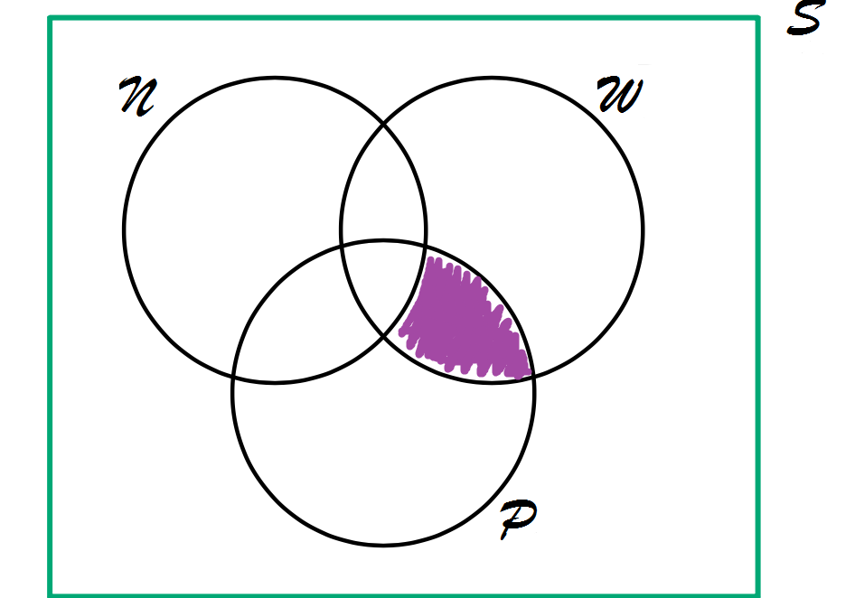
10
=12
22

Slide 31
No Food? Party Pooper!
10
10
9
12

Slide 32
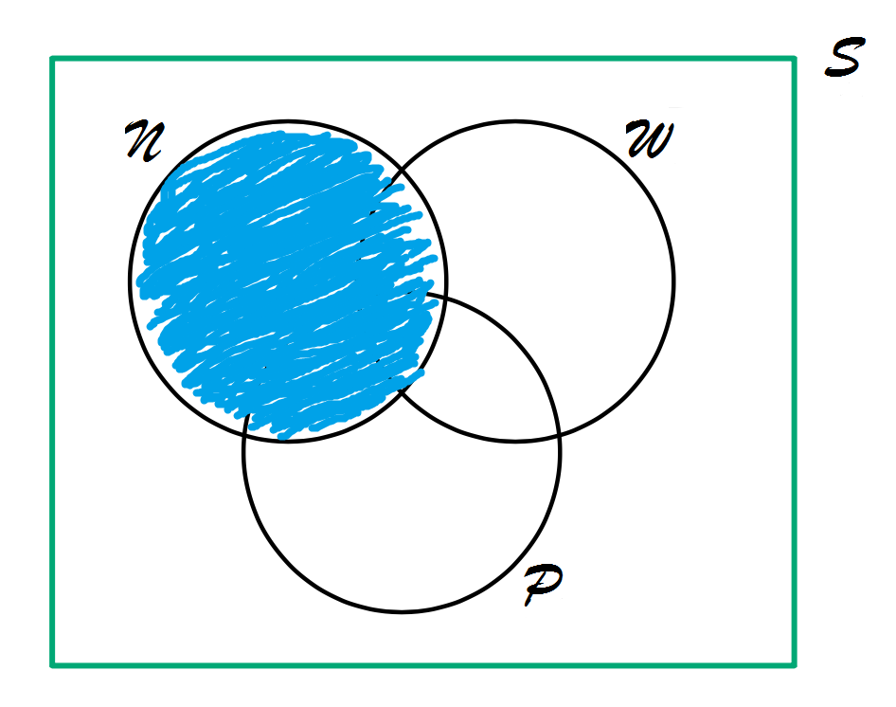
35

Slide 33
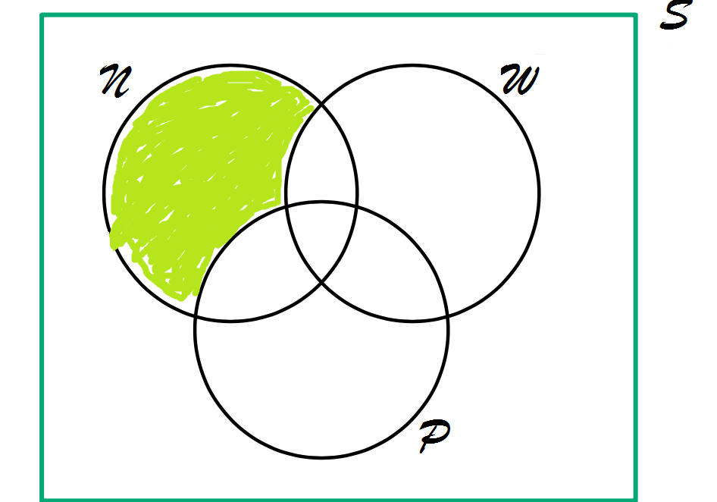
35
20
=6
9

Slide 34
No Food? Party Pooper!
6
10
10
9
12

Slide 35
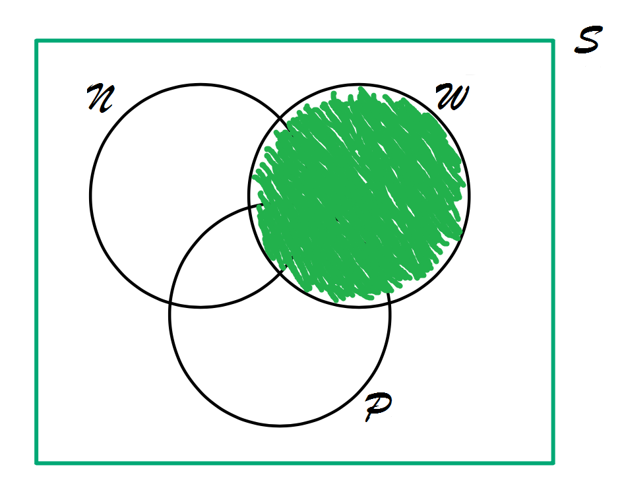
39

Slide 36
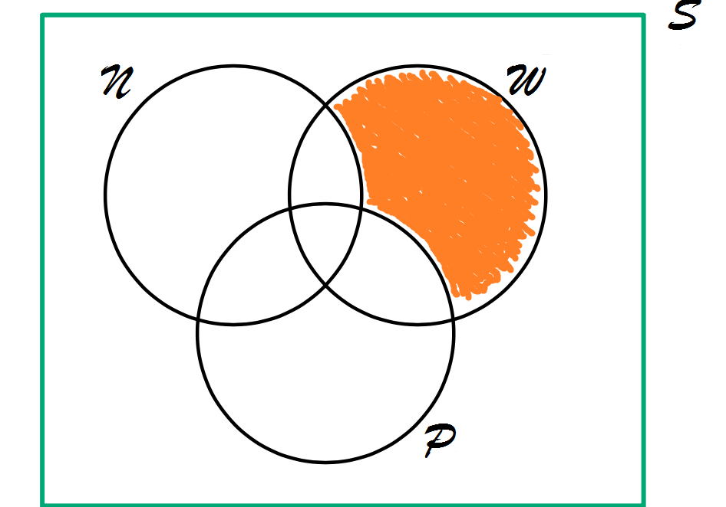
39
10
=7
22

Slide 37
No Food? Party Pooper!
6
10
7
10
9
12

Slide 38
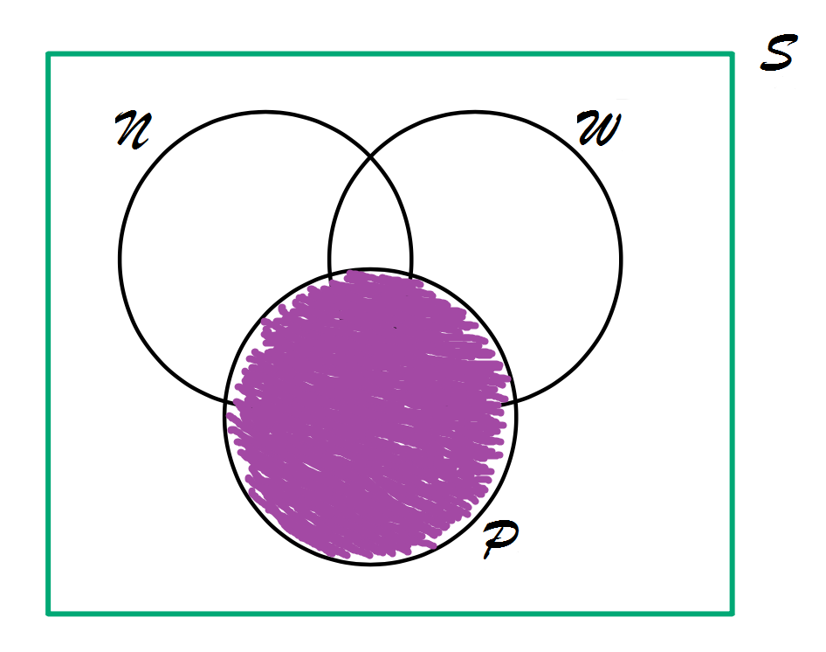
48

Slide 39
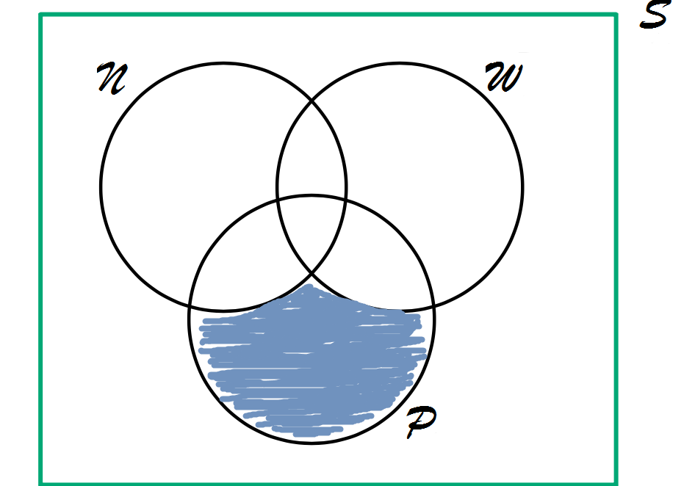
=17
22
9
48

Slide 40
No Food? Party Pooper!
90
-(6+7+10+10+12+9+7+17)
=19
6
10
7
10
9
12
17

Slide 41
Group Work:
Here at UofSC we took a survey of 100 students taking math classes, we found that 48 were taking Calculus
29 were taking Physics
35 were taking Chemistry
3 students are taking all three
15 are taking chemistry and calculus
10 are taking calculus and physics
13 are taking chemistry and physics
How many students are only taking calculus

Slide 42
Cross Product
(Not to be confused with Crossfit)

